Slide 1
Who’s Overpaid? Predicting Player Value Using FIFA Data
Rye Julson
Nico Manzonelli
Jeffrey Mayolo
Joseph Zuccarelli

Slide 2

Introduction
Goal:
Build a model to predict player value from various player physical, athletic, and skill attributes using machine learning models trained on publicly available data from the video game FIFA
Notes:
FIFA is a popular football simulation video game produced by the company EA Sports. Every year EA Sports releases a new version of the game that includes the real-life players on each team. Each player included in the game comes with a large set of attributes concerning their physical features, athletic ability and skill level. For instance, a few popular attributes are height, weight, pace, shooting, passing, dribbling, defending and physical. In real-life, each FIFA player is payed a specific salary value by team ownership based on their production level on the field. However, is it possible that given the large amount of FIFA data concerning each player, we can build a model that provides better estimates of player salaries than human owners?
After conducting EDA, we will attempt to predict player value from various player physical, athletic, and skill attributes using machine learning models trained on publicly available data from the video game FIFA.

Slide 3
Data
Feature | Description
Value | Player’s value measured in Euros (quantitative)
Age | Player’s age (quantitative)
Height | Player’s height measured in (quantitative)
Weight | Player’s weight measured in (quantitative)
Foot | Player’s dominant foot (categorical)
Attacking | Player’s attacking level on 0-100 scale (quantitative)
Skill | Player’s skill level on 0-100 scale (quantitative)
Movement | Player’s movement level on 0-100 scale (quantitative)
Mentality | Player’s mentality level on 0-100 scale (quantitative)
Defending | Player’s defending level on 0 -100 scale (quantitative)
Web Scraping
Primary Features
Inclusion Criteria
Notes:
The website ``sofifa.com" provides relevant and updated FIFA data for each player. After identifying several interesting quantitative and categorical variables for further exploration, we used web scraping via \href{https://www.crummy.com/software/BeautifulSoup/bs4/doc/}{BeautifulSoup} to extract 12,000 relevant player variables. We chose to focus on the following variables: player ID, name, origin country, club, primary position, age, height, weight, primary foot, value, attacking, skill, movement, power, mentality, and defending. Player ID is a unique identifier for each player. Our response variable, player value, is the salary amount for each player in euros. Our predictor variables -- attacking, skill, movement, power, mentality, defending -- represent numerical scores for each player attribute.
After collecting the data, we shifted our focus to cleaning the data in order to enable for further exploration. First, we removed any repeated rows based on player ID. This narrowed our data set to 11,915 unique athletes. Note that we also removed goal keepers from our analysis because not judged based the same variables of interest in this study. This narrowed our data set to 10,792 athletes. Next, we discovered that all observations collected from``sofifa.com" were considered characters; therefore, we properly transformed all quantitative predictors to integers. Finally, we confirmed that our data set does not include any missing values.

Slide 4
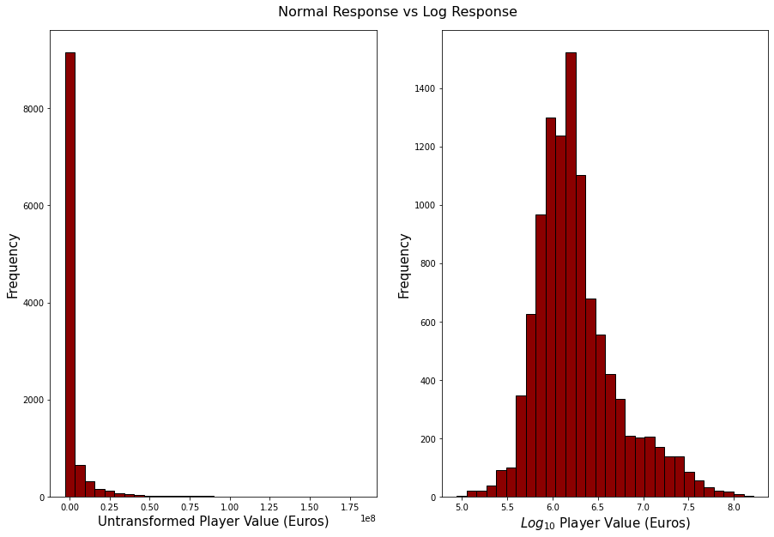
EDA
Notes:
First, we examined the summary statistics for all the variables included in our data set (see \textbf{Table 1}). Notice that the distributions of all the variables included in our data set appear to be relatively symmetric based off the mean and median values, except for defending and player value.
Next, we refined our exploration to the response variable, player value. \textbf{Figure 1} included below displays the distribution of player value for all the observations included in our data set. Notice the strong presence of outliers in the normal response boxplot on the left. Therefore, we used a log base 2 transformation to transform the response variable, as this will allow us to validate the normality assumption of any linear regression model that we may choose to fit in the future. The right plot included in \textbf{Figure 1} shows the distribution of the response variable after a log base 2 transformation. Notice that this distribution appears to be much more normal.
Finally, we explored the relationship between the response variable, player value, and a few of the predictor variables included in our data set. \textbf{Figure 2} included below displays the relationship between player value and the following variables: age, height, weight, attacking, skill, movement, power, mentality, and defending. Notice that there appears to be a positive relationship between player value and the various player attributes, as expected.

Slide 5
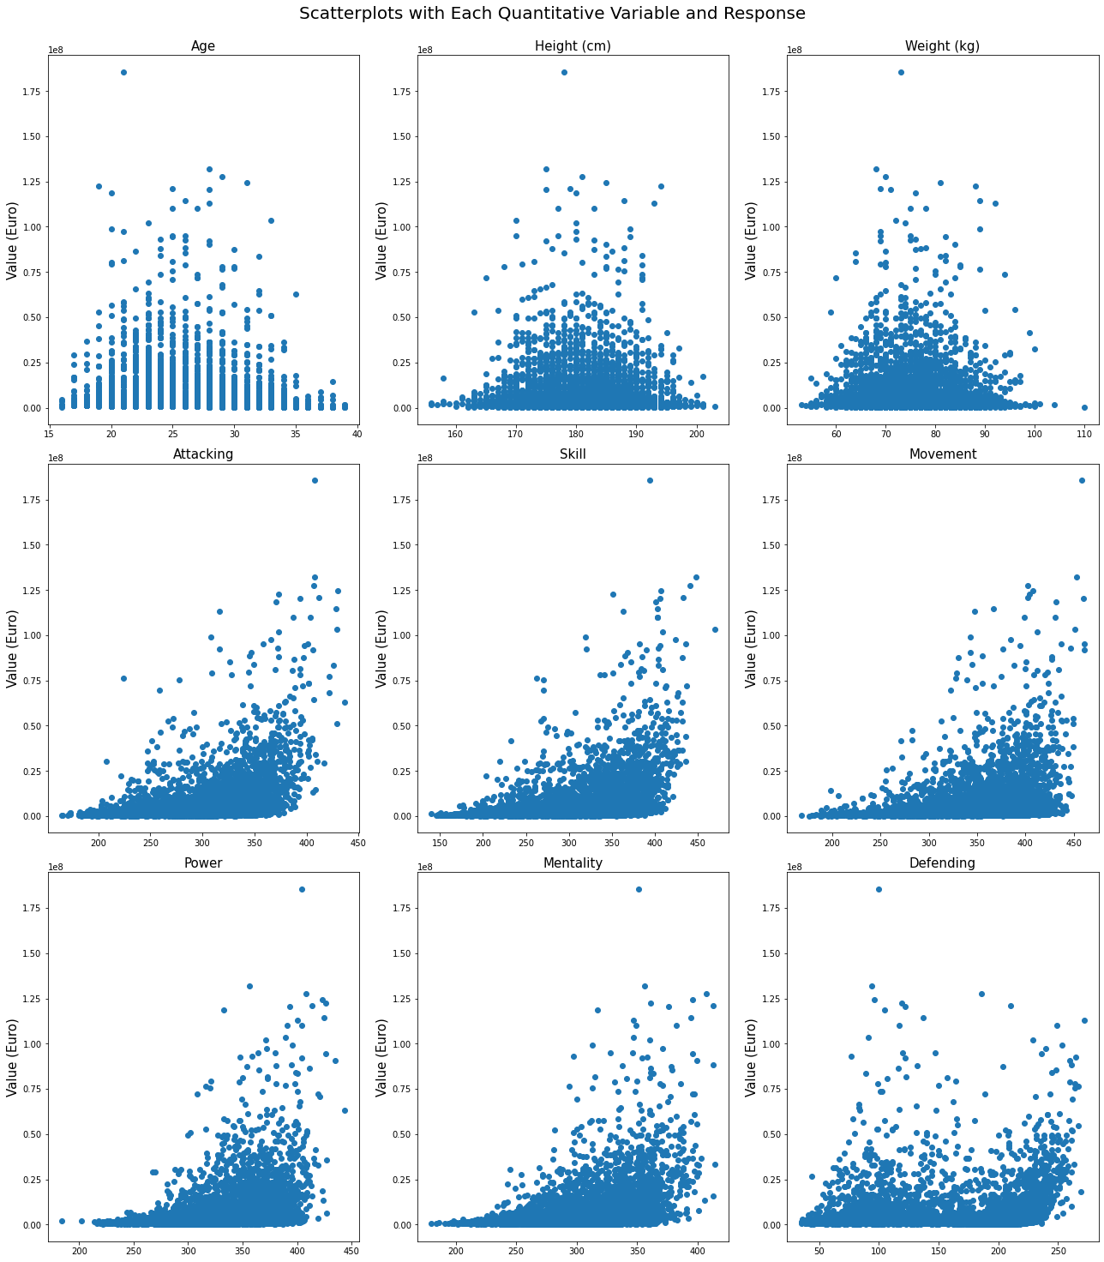
EDA
Notes:
First, we examined the summary statistics for all the variables included in our data set (see \textbf{Table 1}). Notice that the distributions of all the variables included in our data set appear to be relatively symmetric based off the mean and median values, except for defending and player value.
Next, we refined our exploration to the response variable, player value. \textbf{Figure 1} included below displays the distribution of player value for all the observations included in our data set. Notice the strong presence of outliers in the normal response boxplot on the left. Therefore, we used a log base 2 transformation to transform the response variable, as this will allow us to validate the normality assumption of any linear regression model that we may choose to fit in the future. The right plot included in \textbf{Figure 1} shows the distribution of the response variable after a log base 2 transformation. Notice that this distribution appears to be much more normal.
Finally, we explored the relationship between the response variable, player value, and a few of the predictor variables included in our data set. \textbf{Figure 2} included below displays the relationship between player value and the following variables: age, height, weight, attacking, skill, movement, power, mentality, and defending. Notice that there appears to be a positive relationship between player value and the various player attributes, as expected.

Slide 6
Methodology
Model 1: Multi-linear Regression (Baseline)
Model 2: KNN (Hyperparameter: k)
Model 3: Regularized (LASSO) Polynomial Regression (Hyperparameter: α)
Model 4: Decision Tree (Hyperparameter: depth)
Model 5: Random Forest (Hyperparameter: depth)
Model 6: AdaBoost (Hyperparameter: depth)
Model 7: TensorFlow Neural Net

Slide 7
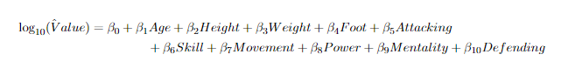
Results (Model 1: Regression)
Train MSE: 0.0883
Validation MSE: 0.0885
NOTE: This model strictly serves as a BASELINE!

Slide 8
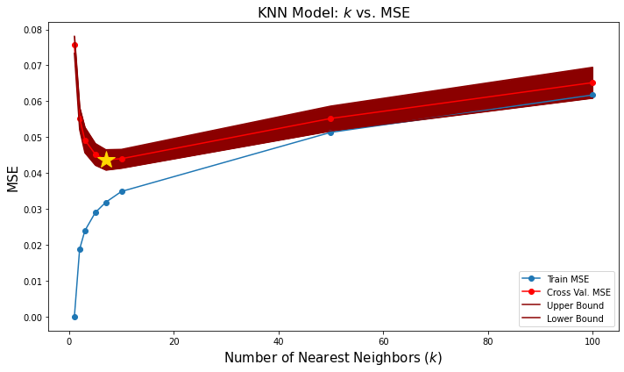
Results (Model 2: KNN)
Train MSE:
0.029
Validation MSE:
0.0452
Optimal Hyperparameter:
k = 5

Slide 9
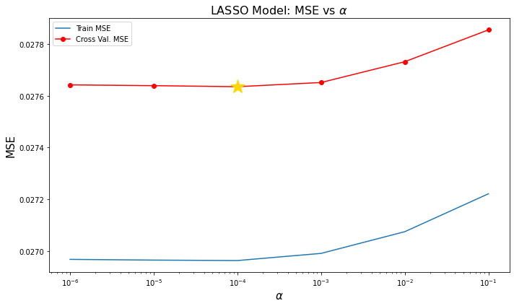
Results (Model 3: Regularized (LASSO) Regression)
Train MSE:
0.0258
Validation MSE:
0.0266
Optimal Hyperparameter:
α = 0.0001

Slide 10
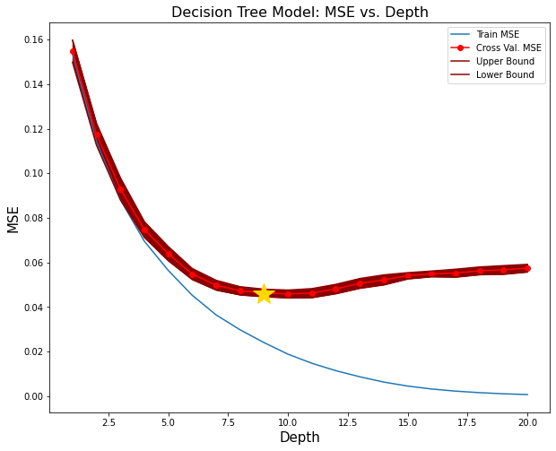
Results (Model 4: Decision Tree)
Train MSE:
0.024
Validation MSE:
0.0449
Optimal Hyperparameter:
depth = 9

Slide 11
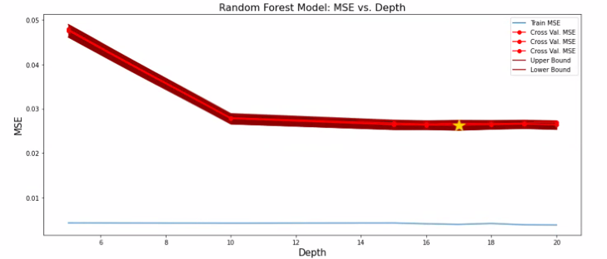
Results (Model 5: Random Forest)
Train MSE:
0.0045
Validation MSE:
0.0263
Optimal Hyperparameter:
depth = 20

Slide 12
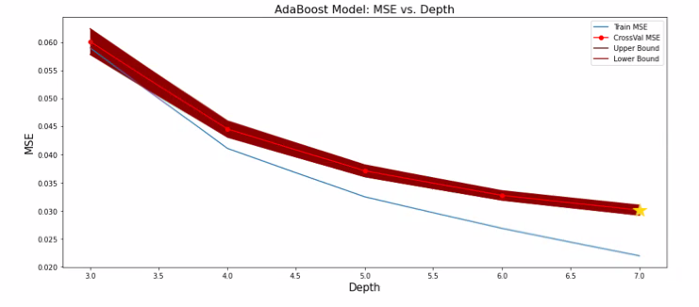
Results (Model 6: AdaBoost)
Train MSE:
0.0224
Validation MSE:
0.0292
Optimal Hyperparameter:
depth = 7

Slide 13
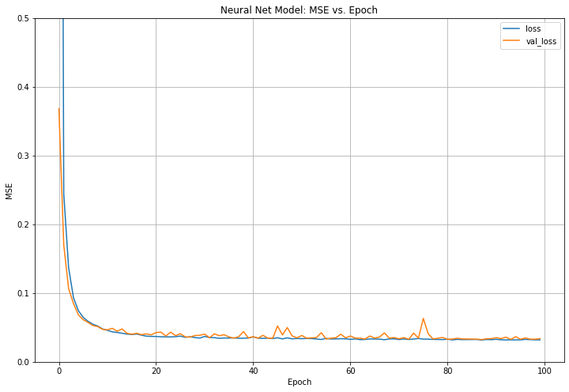
Results (Model 7: TF Neural Net)
Train MSE:
0.0342
Validation MSE:
0.0313
*no tuning

Slide 14
Discussion
Model | Train MSE | Validation MSE
Linear Regression (baseline) | 0.0883 | 0.0885
KNN (k = 5) | 0.029 | 0.0452
LASSO (α = 0.001) | 0.0258 | 0.0266
Single Tree (depth = 9) | 0.024 | 0.0449
Random Forest (depth = 20) | 0.0045 | 0.0263
AdaBoost (depth = 7) | 0.0224 | 0.0292
TF Neural Net *no tuning | 0.0342 | 0.0313
Best Model:
LASSO Regression
Test MSE:
0.0287
Test R-squared:
0.8578

Slide 15
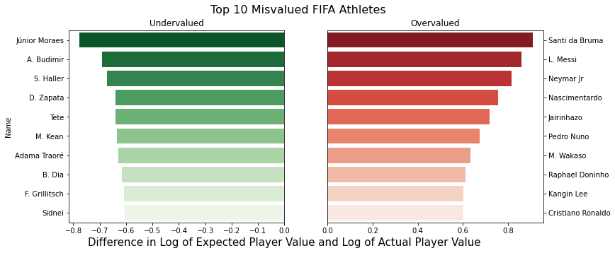
Discussion

Slide 16
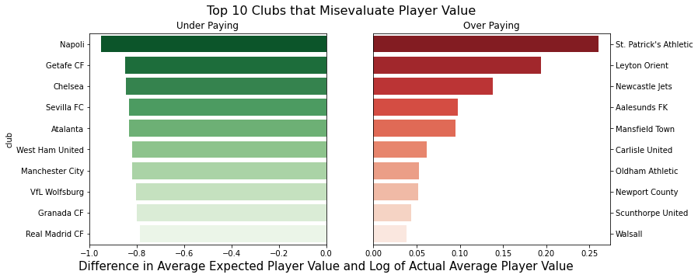
Discussion

Slide 17

Discussion
Limitations: The model does not account for many other factors that determine player worth
Future Work: Can we account for potential bias in player value based on race or nationality?

